Slide 1

US Retail Sales & Public Holidays Analysis
2014-2017
Data Management Project
February 10, 2026
Team Members
Abdul Sami - Mat: 939542 Davina David - Mat: 946851

Slide 2

Project Overview & Objectives
Executive Summary: Analysis of 9,994 retail orders (2014–2017) integrated with official US public holiday data from the Nager.Date API. The study examines how public holidays influence daily e-commerce order volumes and whether holiday information improves predictive forecasting.
Primary Objective: To quantify how public holidays affect retail order behavior and assess their value in predictive modeling of daily sales.
Key Research Questions:
RQ1: Do public holidays significantly affect daily e-commerce sales?
RQ2: Are order volumes higher on holidays compared to non-holidays?
RQ3: Which US holidays have the greatest impact on ordering patterns?
RQ4: Does including holiday information improve prediction of daily order volumes?

Slide 3

Data Acquisition
Retail Orders Data:
Four yearly datasets (2014–2017) originally in Excel, later converted to CSV and merged.
Key fields: Order ID, Order Date, Customer ID, Product ID, Sales, Quantity.
Initial scale: 9,994 records.
Public Holiday Data:
Retrieved via the Nager.Date API for 2014–2017 (four separate endpoints).
Fields used: date, name, countryCode (US).
Combined into a single dataset after extraction.
Processing Environment:
All data processing and analysis conducted in Python using Jupyter Notebooks.

Slide 4

Data Profiling & Quality Assessment
Retail Orders Dataset:
9,994 total records
0 missing values
0 duplicate records
Public Holidays Dataset:
60 unique holiday dates initially
0 missing values
8 duplicate dates detected (13.33%)
Quality Dimensions Assessed:
Completeness: Checked using .isnull().sum()
Uniqueness: Verified using .duplicated().sum()
Validity: Ensured correct data types using .dtypes and pd.to_datetime()
Consistency: Ensured alignment between Order Date and Holiday Date for integration

Slide 5

Data Cleaning & Quality Improvement
File Consolidation:
Four yearly (2013-2017) retail files merged into one dataset (9,994 rows).
Four holiday API responses combined into a single CSV.
Duplicate Handling & Missing Values:
Retail Orders: No duplicates, no missing values.
Public Holidays: 8 duplicate dates removed → 52 unique holiday dates.
Data Standardization:
Converted all dates to datetime64[ns].
Created a binary IsHoliday column for standardized labeling.
Renamed columns for consistency (e.g., date → Holiday Date).

Slide 6

Data Integration & Storage
Integration Strategy:
Left join between Retail Orders and Public Holidays on Order Date.
Ensured no loss of retail data during integration.
Integration Results:
Total records after integration: 9,994 (unchanged).
Orders on holidays: 450 (4.50%).
Orders on non-holidays: 9,544 (95.50%).
Storage Architecture:
Data stored in SQLite (relational database) for simplicity, portability, and reproducibility.
Bulk inserts used to maintain data integrity.
Enrichment Fields Added:
Holiday Name
IsHoliday (True/False)

Slide 7
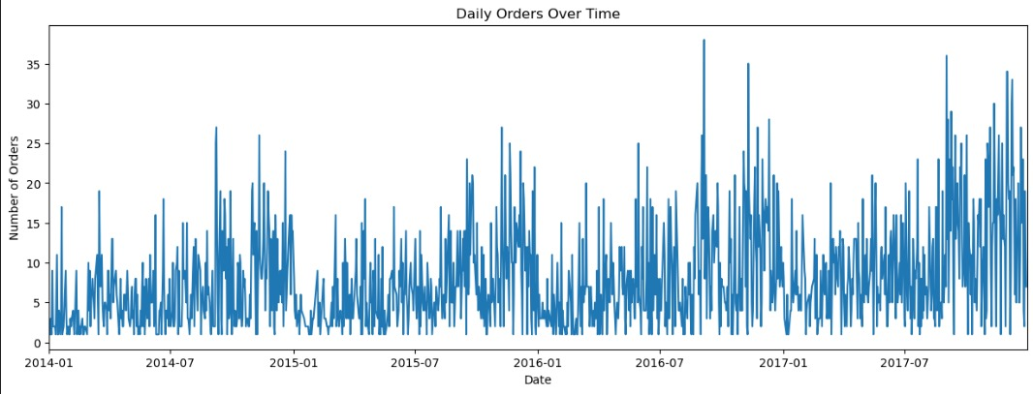
RQ1 – Impact of Holidays on Daily Sales
Key-Features
Time period: Jan 2014 – Jul 2017 (daily orders)
Fluctuations: Noticeable day-to-day variability in orders
Seasonality: Higher volumes in certain months (likely holidays/promotions)
Spikes: Distinct peaks likely linked to special events
Results
Overall trend: Generally stable demand with irregular fluctuations

Slide 8
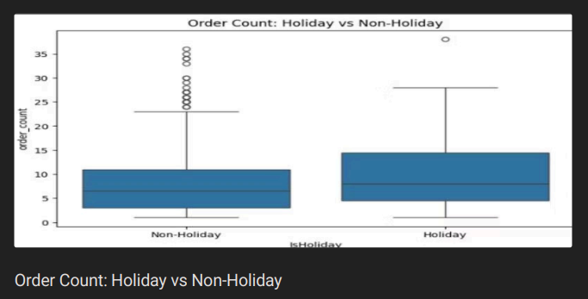
RQ2 – Holiday vs Non-Holiday Order Volumes
Key Features:
Boxplot Comparison: Compares order count on Holidays vs Non-Holidays.
Order Range: The y-axis shows order counts, ranging from 0 to 35.
Outliers: More outliers (dots) are seen in the non-holiday category.
Results:
Holiday Orders: Lower median order count (~6), with fewer outliers.
Non-Holiday Orders: Higher median order count (~8), with more variation and outliers, indicating more inconsistent order volumes.

Slide 9
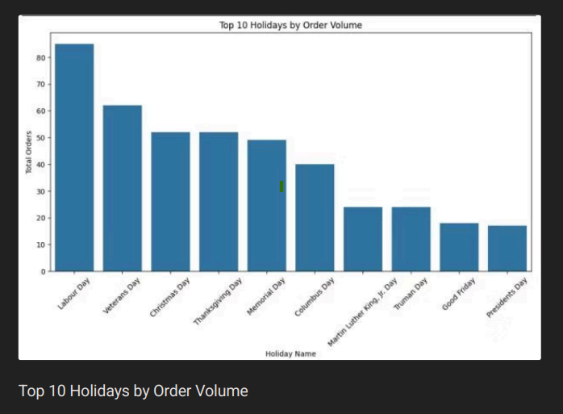
Analysis: Holiday Type Effects (RQ3)
Key Features:
X-axis: Represents different holidays.
Y-axis: Represents the total orders (order volume) placed on each holiday.
Bars: The height of the bars indicates the total number of orders for each holiday.
Results:
Labour Day has the highest order volume, with more than 80 orders.
Veterans Day follows closely, with around 70 orders.
Christmas and Thanksgiving show notable, but lower, order volumes than the top holidays.
Order volumes decline from Columbus Day to Presidents Day, with Presidents Day the lowest.

Slide 10
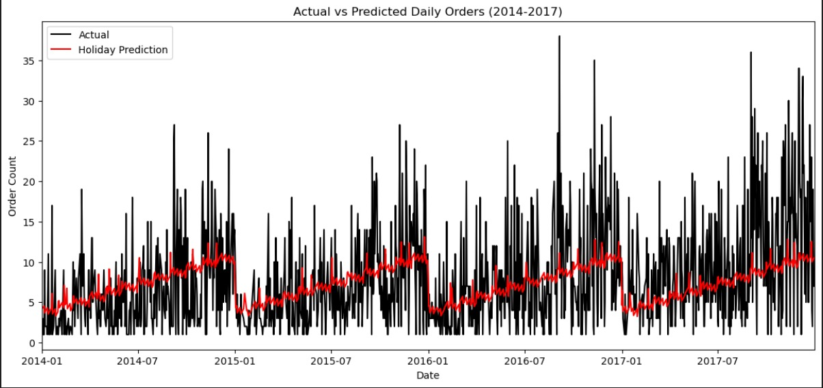
Analysis: Predictive Modeling (RQ4)
This time-series graph compares actual daily orders (black line) with holiday predictions (red line) from 2014 to 2017.
Key Points
Actual vs. Predicted: The black line shows actual order counts, while the red line shows predicted orders based on holidays.
Deviations: Actual orders often exceed predictions, especially during holidays, suggesting unforeseen demand surges.
Seasonality: The predictions align with holiday patterns, but actual orders show higher-than-expected demand during some periods.
Key Insight: Predictions capture holiday trends but tend to underestimate actual demand, pointing to potential improvements in forecasting models.

Slide 11

Conclusion & Findings
Conclusion
Primary Driver: Public holidays are a significant factor influencing daily e-commerce sales patterns.
Summary of Findings:
Holidays significantly affect customer ordering behavior.
Sales volumes are generally higher on holidays.
Certain holidays (i.e. Labour Day, Veterans day, and Christmas) drive the largest spikes.
Incorporating holiday indicators improves predictive accuracy.

Slide 12

References
References Kaggle. (2017). US Retail Store Sales (2014– 2017). Available at:
https://www.kaggle.com/datasets/v1shalsb/us-retail-store-sales-2014 2017-yearly-split
Nager.Date API. (2014–2017). Public Holidays in the United States. Available at:
https://date.nager.at/api/v3/PublicHolidays/2014/us
https://date.nager.at/api/v3/PublicHolidays/2015/us
https://date.nager.at/api/v3/PublicHolidays/2016/us
https://date.nager.at/api/v3/PublicHolidays/2017/us

Slide 13


